Slide 1
What gives BTC security?

Slide 2
Overview
What is Financial Security?
Immutability
Censorship Resistance
Decentralization
What makes a Transaction Legitimate?
The Double Spend Problem
UTXO Model (BTC) vs. Account Model (ETH)
Proof of Work, Proof of Stake, Proof of Authority
Weaknesses
Exchanges
Mt. Gox

Slide 3
Financial Security
Why is this Important?
Under the current system, VISA, your bank, and even your employer can unilaterally reverse any payment you’ve ever made or withdraw funds from your accounts.
Since these are all centralized, physical institutions, anyone with force or power (governments, cartels, etc.) can coerce these companies to withdraw your funds or reverse payments.
Immutability of the Ledger:
Once a transaction is placed in a block and broadcast to the entire network (mined), other nodes will validate it and add it to their own ledger. Once this happens, the transaction cannot be reversed.

Slide 4
How is Bitcoin Censorship Resistant?
A few factors make BTC Censorship Resistant:
Everyone running a Mining Node can decide which transactions (from the Mempool) to include in their block. A vast majority of nodes simply auto-select TXs with the highest fees.
Miners don’t know who is signing inputs. The typical block (1MB) contains ~2500 TXs. Exhaustive chain analysis would be required to blacklist specific people.
If one miner decides to blacklist an address or a person, another miner can easily add it to their block.
If another miner mines a block and includes the TX you would like to censor, there is no way to broadcast its invalidity to other nodes, so all other nodes would accept the block (and the TX)

Slide 5
Censorship Resistance
This is probably the scariest aspect of Bitcoin to most governments and non-believers.
This allows criminals to transact across borders (Silk Road)
However, Bitcoin is only pseudonymous, not anonymous, so cash (mostly untraceable) remains by far the superior currency for illicit activities.
Anyone Anywhere can Pay Anyone Anywhere.
Note:
BTC does not uniquely assist in money laundering. Nearly every bank in the world has been fined for funding criminals, terrorists, etc. and the Big Banks pay yearly fines to avoid being prosecuted for this.
More importantly, since BTC’s ledger is 100% public, it is far more transparent than any bank.

Slide 6
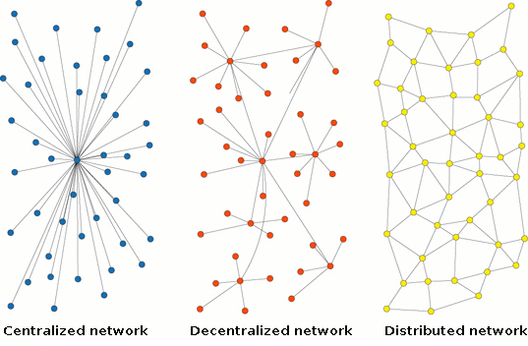
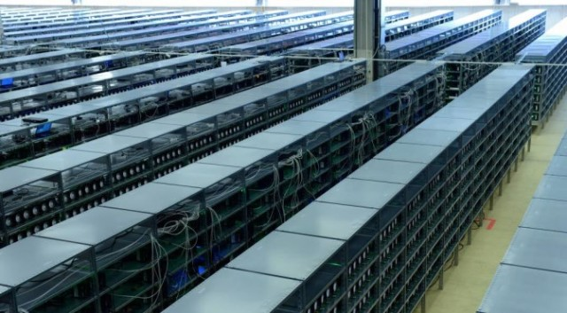
Decentralization
A foundational pillar of Bitcoin is the decentralized nature of the system. However, due to the slim profit margins, regulation, high energy costs, and a steep learning curve, a few Mining Pools have become very large.
Bitmain was one of the first Mining pools to accumulate a large share of hashpower. This was due to their far superior tech (ASICs) and China’s cheap excess energy.
Razor thin margins and fluctuating energy prices cost Bitmain a fortune, and in late 2018-2019 the company signaled insolvency.
Bankruptcy and dissolution will likely follow.
A Mining Farm run by Bitmain’s Jihan Wu.

Slide 7
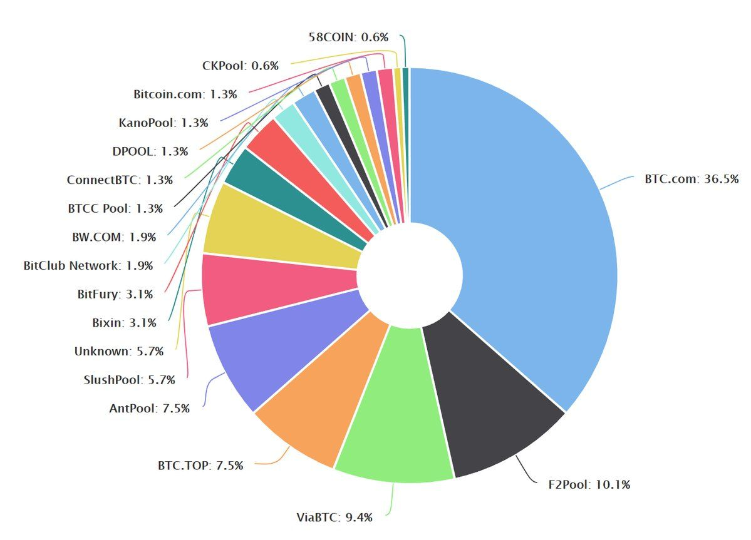
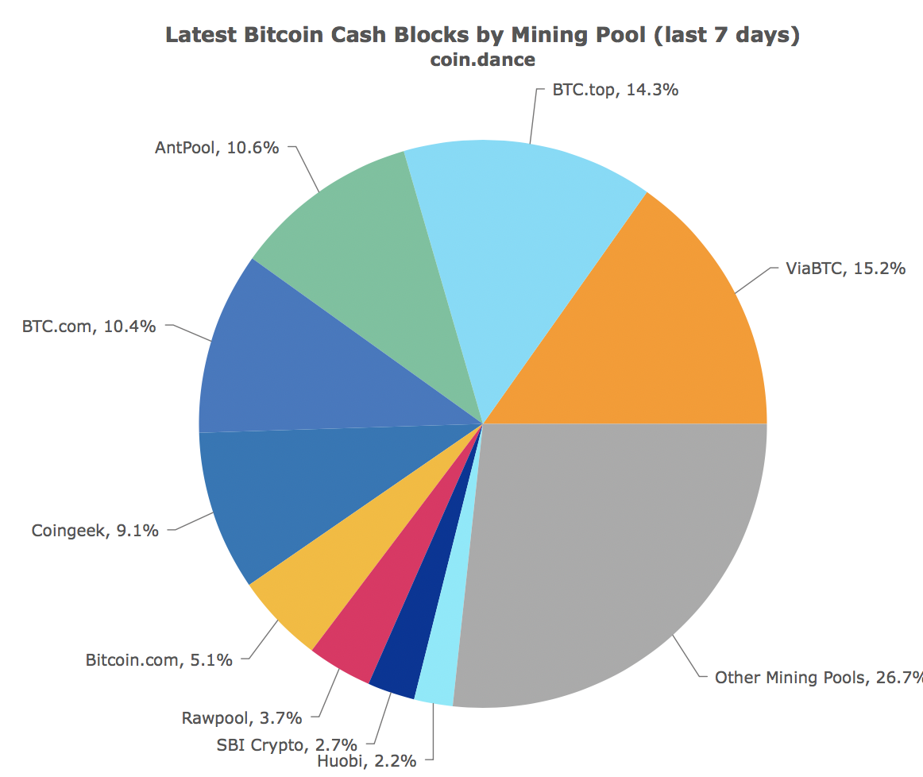
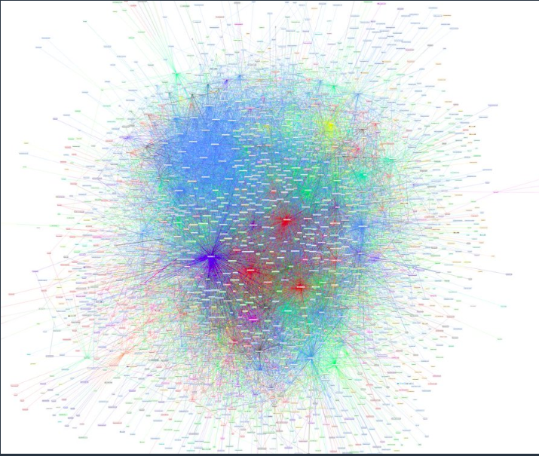
Centralization Visualized
2017 Mining Pools 2018
Lightning Network
These two charts are from 2017 and 2018 respectively. Decentralization is being achieved slowly but remains an issue. For altcoins with lower hashpower, this is a far more dangerous problem, ie. ETC example!
The gray portion of the Graph on the left is “Other”
The three red clusters are large hubs on the Lightning Network. More on LN centralization later.
2018
Notes:
ETC suffered a 51% attack in early january 2019. A whitehat hacker rented or controlled roughly 50% of the hashpower and, through an exchange, sold ETC before reorganizing the blockchain to recover it. Around $200k worth of ETC was stolen, but all was voluntarily returned. Through all of this, ETC saw an increase in price.

Slide 8

The Double-Spend Problem
When the Internet was first invented by Al Gore, the developers envisioned a digital cash fully integrated with the internet.
We’ve all seen Error 404 Not Found, which indicates a failed website load, but Error 402 was meant to signal a failed payment.
Along with other problems, the Developers were never able to integrate a native payment system because of the Double Spend Problem.

Slide 9
How Bitcoin Solves the Double-Spend Problem*
1: It doesn’t. In 2016, Peter Todd, a BTC Core developer, double spent on Coinbase, the biggest exchange in the world. He posted the python script to do so on GitHub, where it’s still available.
2: It mostly does. Most developers, including Todd, have dismissed this as a major problem, because it only tricks exchanges/people who don’t wait for (6+) confirmations or run their own node.

